Slide 1



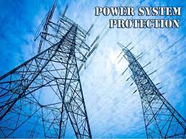
BRANCH : ELECTRICAL ENGINEERING
SEMESTER: 6TH
ELECTRIC POWER SYSTEM PROTECTION(EPSP)

Slide 2
Table of Contents
Introduction: Principle and need for protective schemes, Nature and causes of faults, Zones of protection, Primary and back-up protection, Basic principle of operation of protective system, Components of Protection System. Sequence Components and Fault Analysis: sequence impedance, fault calculations, Single line to ground fault, Line to ground fault with Zf, Faults in Power systems, Concept of short circuit capacity of a Bus.
  Operating Principles and Relay Construction: Relay design and construction, Relay classification, Types of Electromagnetic relays, Theory of Induction relay torque, General Equations of Comparators and Electromagnetic Relays, Over Current relays, Directional relays, Distance relays, Differential relays. Feeder Protection: Over current, Distance and Pilot Protection. Static Relays: (Comparators and different relays) Amplitude comparator, Phase Comparator, Coincidence type phase comparator, Basic elements of a static relay, Over Current Relays, Differential Protection, Static distance Protection.
01
02

Slide 3
Table of Contents
Apparatus Protection: Transformer Protection, Generator Protection, Motor Protection,
Bus bar protection schemes. Numerical relays: Block Diagram of Numerical Relay, Signal Sampling & Processing, Numerical Over-current protection, Numerical Transformer differential Protection, Numerical distance Protection of Transmission Line.
Switchgears: Auto reclosing, Theory of Circuit interruption, Circuit constants in relation to Circuit breaking, Re-striking voltage transient, characteristics of Re-striking Voltage,
Interaction between breaker and circuit, Current chopping. Circuit Breakers: Types of circuit breakers (air blast, air break, oil, vacuum, SF6 , DC circuit breaker), advantages and testing of circuit breaker.
03
04

Slide 4
  MODULE-01
  INTRODUCTION TO POWER SYSTEM PROTECTION

Slide 5
To discuss:
Introduction: Principle and need for protective schemes
Nature and causes of faults, Zones of protection
Primary and back-up protection,
Basic principle of operation of protective system, Components of Protection System.
Sequence Components and Fault Analysis: sequence impedance,
fault calculations, Single line to ground fault, Line to ground fault with Zf, Faults in Power systems, Concept of short circuit capacity of a Bus.

Slide 6
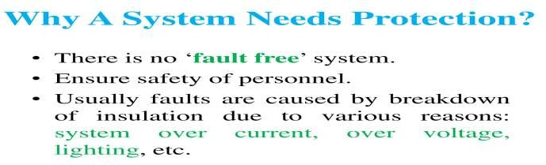
What is System protection?
System protection is the art and science of detecting problems with power system components and isolating these components.

Slide 7
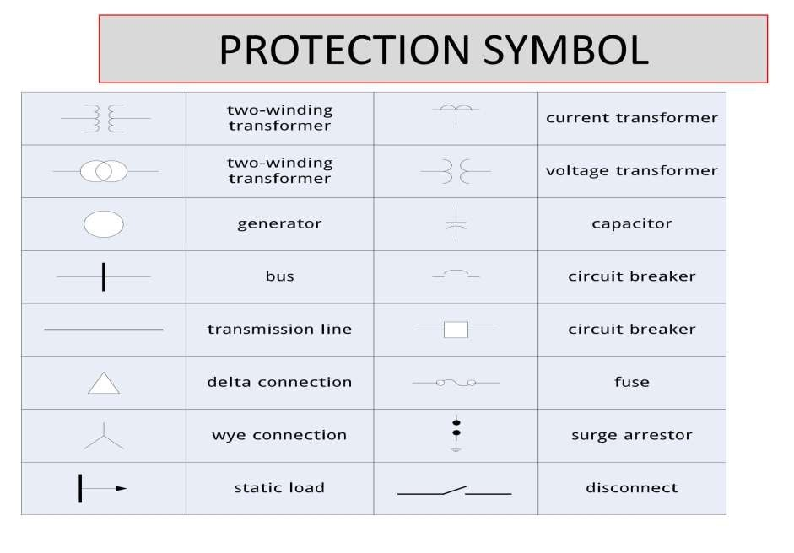
PROTECTION SYMBOL

Slide 8
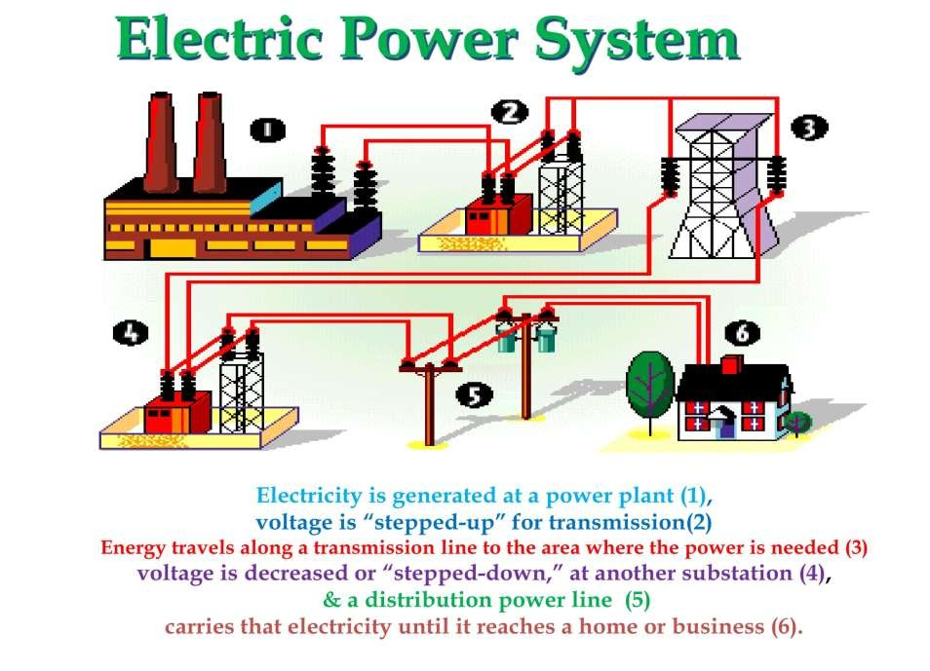

Slide 9
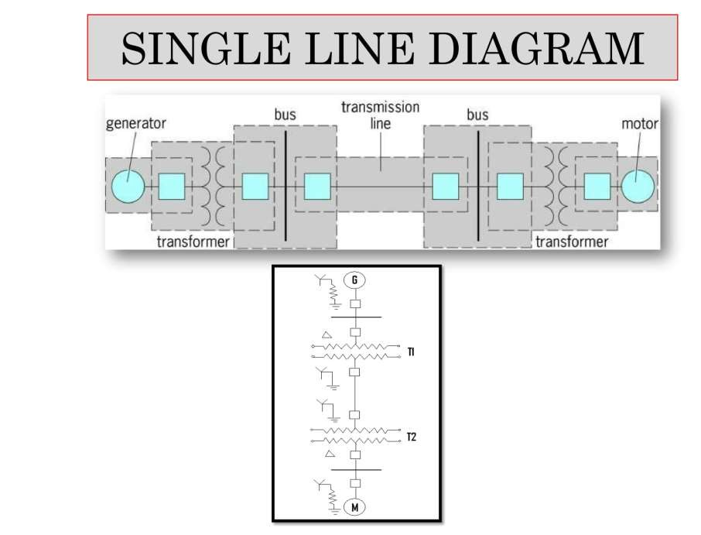

Slide 10
Needs for the protection
The power system must maintain acceptable operation 24 hours a day
Voltage and frequency must stay within certain limits
Protect the public
Improve system stability
Minimize damage to equipment
Protect against overloads

Slide 11
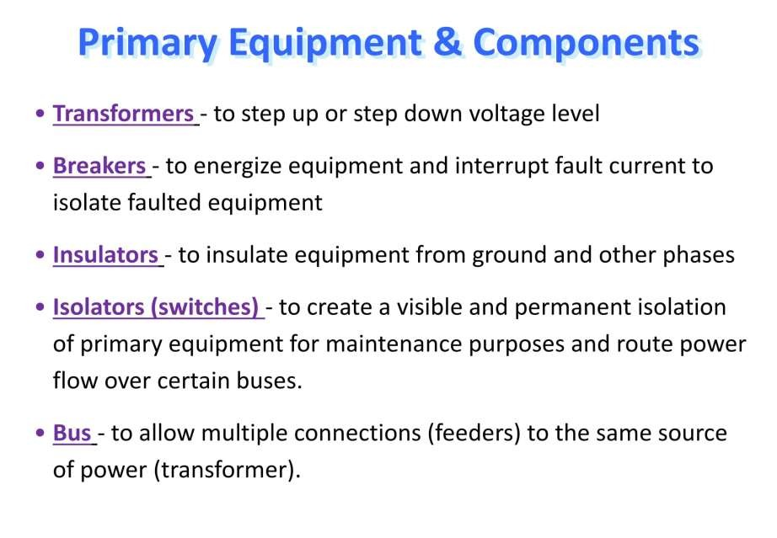

Slide 12
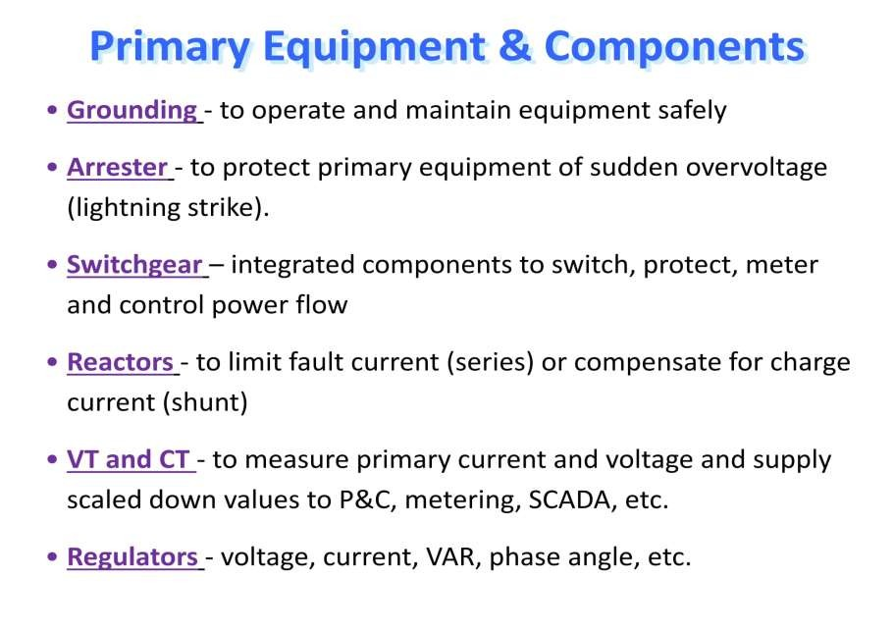

Slide 13
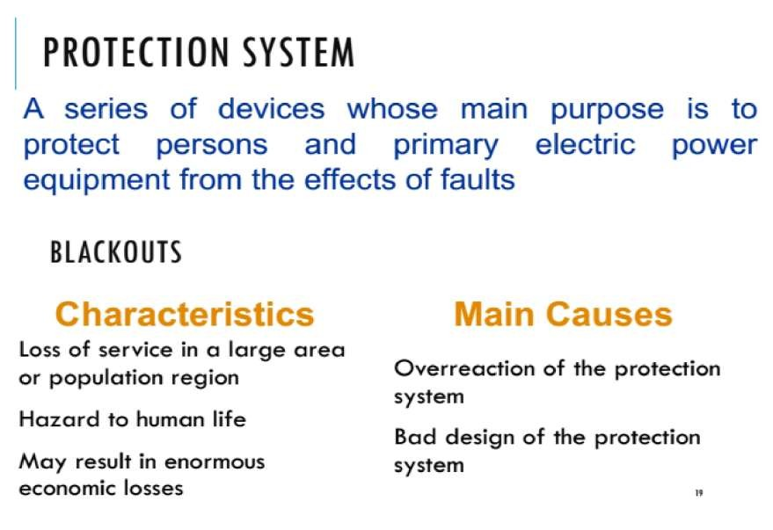

Slide 14
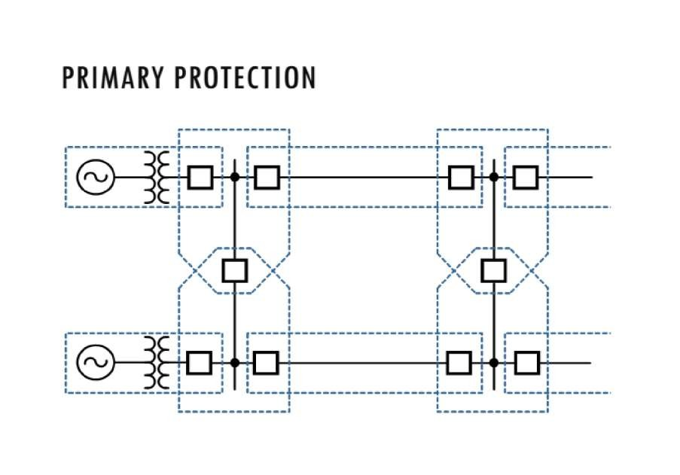

Slide 15
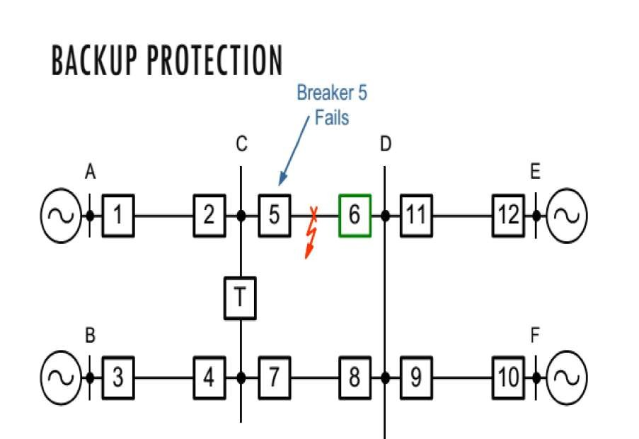

Slide 16
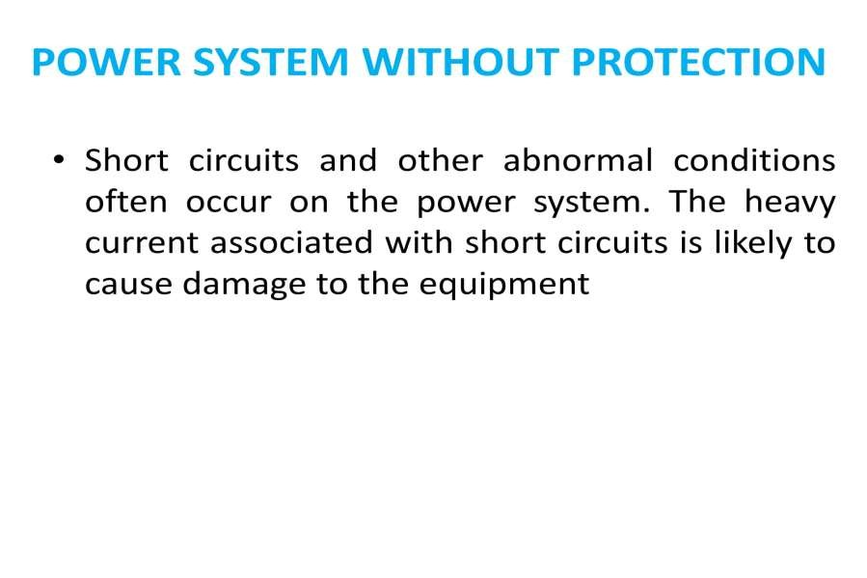

Slide 17
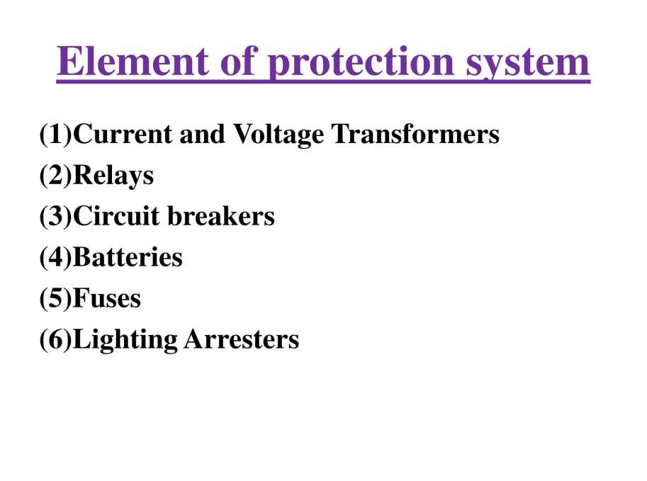

Slide 18
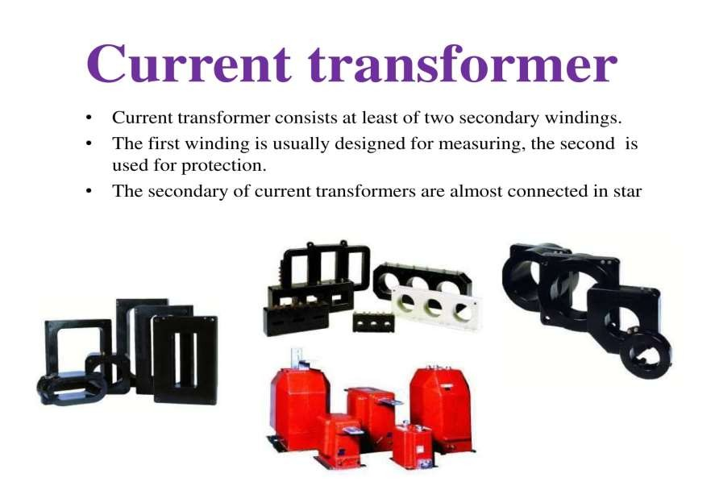

Slide 19
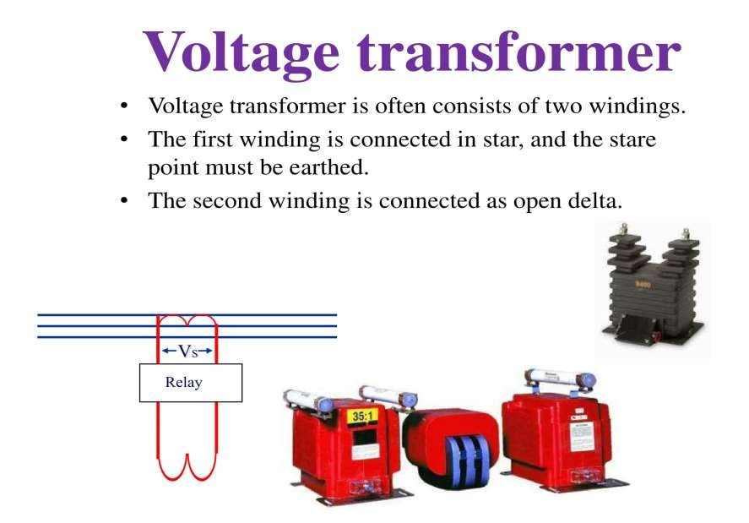

Slide 20
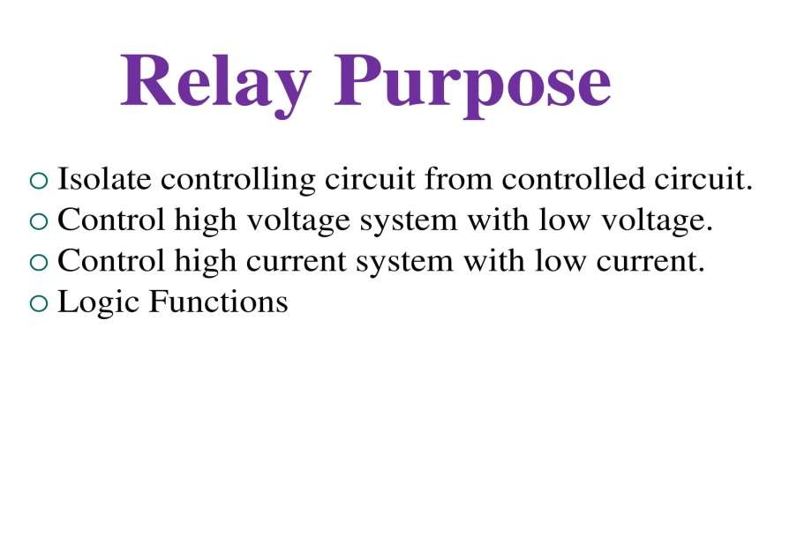

Slide 21
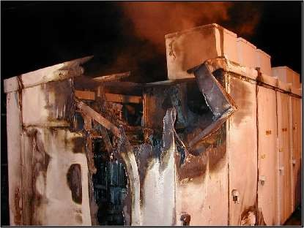
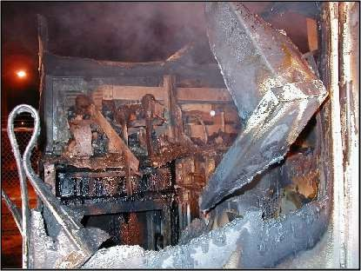
Damage to Main Equipment

Slide 22
FAULT IN POWER SYSTEM
Symmetrical fault
Faults giving rise to equal currents in lines displaced by
equal phase angles i.e 120º in three phase systems.
Example: short circuit of all three phase
conductors of a cable at a single location
Unsymmetrical fault
Faults in which not all the line currents are equal and not all have the same phase.
Example (any one): single phase line to ground fault (L-G), two phase to ground (LL-G) fault and phase to phase (L-L) fault.

Slide 23
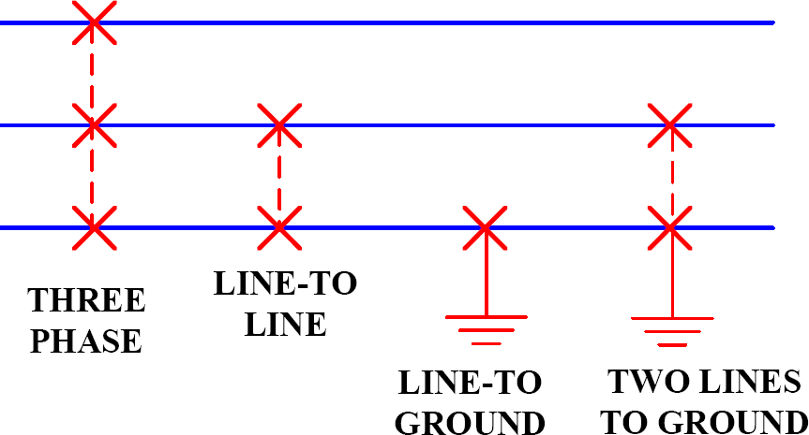
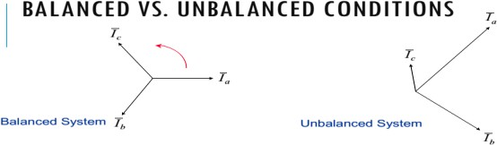
Fault Types (Shunt)

Slide 24
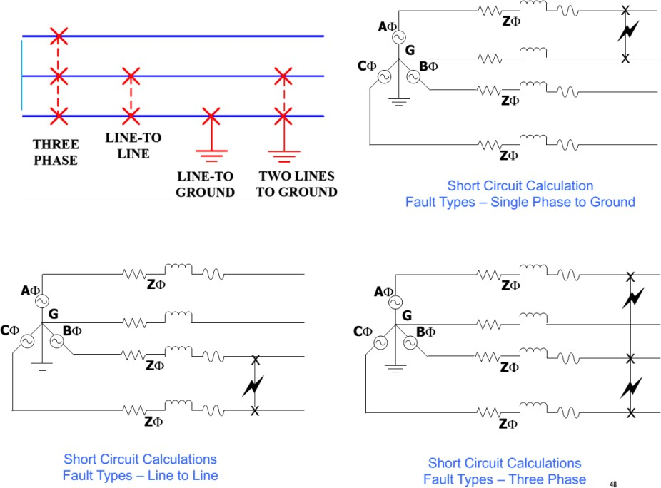
Fault Types (Shunt)

Slide 25
TYPES OF FAULTS
Single-Phase-Ground: 70–80%
Phase-Phase-Ground: 17-10%
Phase-Phase: 10-8%
Three-Phase: 3-2 %

Slide 26
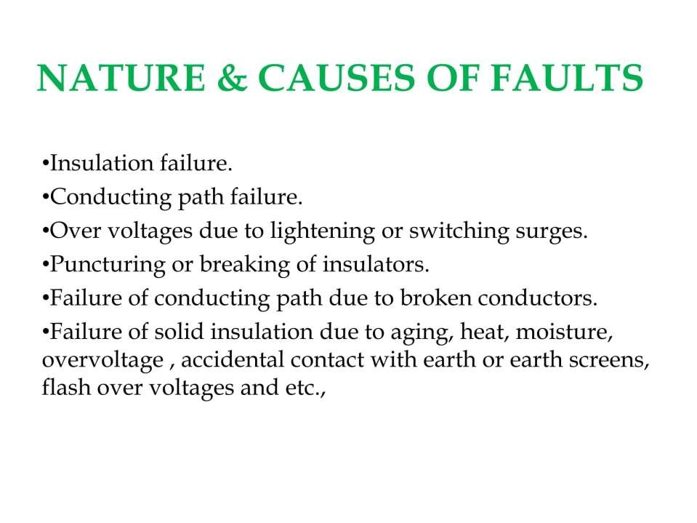

Slide 27
Components to be protected
Generators
Transformers
Lines
Buses
Capacitors

Slide 28
Fault Minimization
Improving the quality of machines, equipments, installation etc., by improving the design techniques.
Adequate & reliable protection system control
Regular maintenance by trained professionals
Effective management of electrical plant

Slide 29
Merits of Fast fault clearing
Helps to avoid permanent damage to equipment & components of the apparatus
Reduces the chances of risks like fire hazards
Maintains the continuity of the power supply
Brings back the power system to the normal state sooner

Slide 30
  MODULE-02
OPERATING PRINCIPLE AND RELAY DESIGN

Slide 31


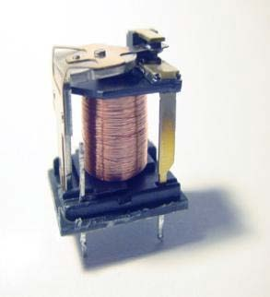
Relays are electrical switches that open or close another circuit under certain conditions.
Isolate controlling circuit from controlled circuit.
Control high voltage system with low voltage.
Control high current system with low current.
Logic Functions

Slide 32
Types of Relays
Electromagnetic Relays (EMRs)
Solid-state Relays (SSRs)
  There is no mechanical contacts to switch the circuit.
Microprocessor Based Relays
Commonly used in power system monitoring and protection.

Slide 33

Electromagnetic Relays (EMRs)
  Simplicity
  Not expensive
Solid-state Relays (SSRs)
  No Mechanical movements
  Faster than EMR
Microprocessor-based Relay
  Much higher precision and more reliable and durable.
  Capable of both digital and analog I/O.
  Higher cost

Slide 34

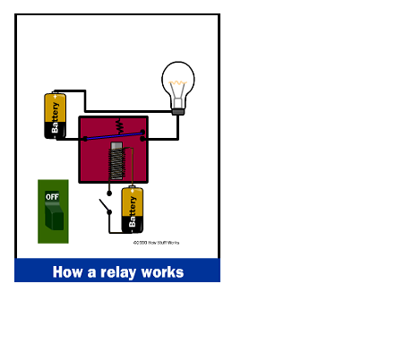
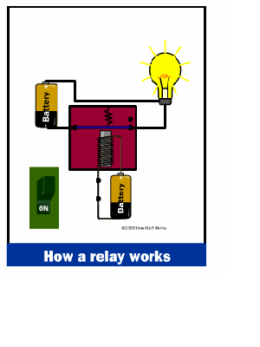

Slide 35
Relay Definitions
Primary Relay: relay connected directly in the circuit
Secondary Relay: relay connected to the protected circuit through CT & VT.
Auxiliary Relay: relay operate in response to opening or closing of another relay.
Measuring Relay: It performs the measurement of normal & abnormal conditions in the power system.
Electro –Magnetic Relay: It operates on the principle of Electromagnetic induction.
Static Relay(Solid-state relay): They use diodes , transistors , SCRs , Logic gates etc.
(Static circuit is the measuring circuit & no moving parts)
Microprocessor Based Relay: All functions of a relay can done by using microprocessor . Relays are programmable.
µP can compare , compute and send trip signals.

Slide 36
Relay Definitions
Thermal Relay: It operates on the principle of Electro- thermal effect.
Distance Relay: relay measures the impedance or reactance or admittance.
Impedance Relay: relay measures the impedance of the transmission line.
Reactance Relay: relay measures the reactance of the transmission line.
Over-current Relay: relay operates when the current exceeds a pre-set value.
Under-voltage Relay: relay operates when the voltage falls a pre-set value.
Directional Relay: relay able to sense whether fault lies in forward or reverse direction.
Polarized Relay: relay depends on the direction of the current.

Slide 37
Relay Definitions
Differential Relay: it measures the difference b/w 2 actual quantities.
Earth fault Relay: It is used for protection of element of a power system against Earth faults.
Phase fault Relay: It is used for protection of element of a power system against phase faults.
Negative Sequence Relay: relay uses negative sequence current as its actuating quantity.
Zero Sequence Relay: relay uses zero sequence current as its actuating quantity.

Slide 38
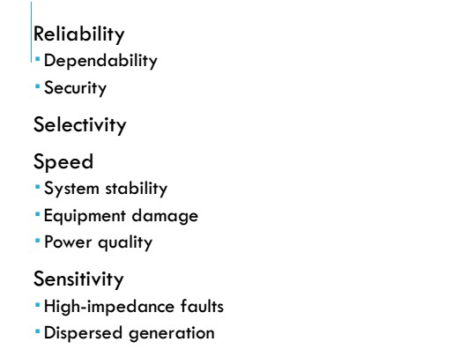

Requirement of Protective
System

Slide 39
Descriptions
Reliability
The level of assurance that the relay will function as intended.
Reliability denotes:
  Dependability - certainty of correct operation
  Security - assurance against incorrect operation
Sensitivity
Relaying equipment must be sufficiently sensitive so that it will operate when required
Must discriminate normal from abnormal conditions.

Slide 40
Descriptions
Selectivity
Performance of protective devices to select between those conditions for which prompt operation and those for which no operation, or time delay operation is required.
Isolate faulted circuit resulting in minimum interruptions.
Implemented through “Zone of Protection”
Speed
Remove a fault from the power system as quickly as possible
Classification:
  Instantaneous - no intentional delay
  High Speed - less than 3 cycles
  Time-Delay - intentional time delay

Slide 41
Reliability
assurance that the protection will perform correctly.
Selectivity
maximum continuity of service with minimum system disconnection.
Sensitivity
To detect even the smallest fault, current or system abnormalities and operate correctly at its setting
Speed
minimum fault duration and consequent equipment damage and system instability.
minimum protective equipment and associated circuitry to achieve the protection objectives.
Simplicity

Slide 42
Neutral Grounding
Connecting neutral point to earth (i.e. soil) either directly or some circuit element (e.g. resistance, reactance , Peterson coil etc.) is called neutral grounding.
Neutral grounding provides protection to equipment.
(during earth fault, the current path is completed neutral)

Slide 43
Advantages of Neutral Grounding
Voltages of the healthy phases do not exceed line to ground voltage i.e. they remain nearly constant.
The high voltages due to arcing grounds are eliminated.
Life of insulation is long.
The over voltages is reduced.
It provides greater safety to personnel and equipment.
It provides improved service reliability.
Operating and maintenance expenditures are reduced.

Slide 44
Protection Against Over Voltage Due to Lightning & Switching
During Operation , PS equipments such as Generator, transformer, Transmission lines may subject to Over Voltage.
OV occurs due to Lightning, opening of CB & so on.
Causes Of OV
  Internal Cause
    External Cause

Slide 45
Electromagnetic Relay
They work on the following two main operating principles :
Electromagnetic attraction
Electromagnetic induction
Electro magnetic attraction Relays
(i)Attracted armature type relay
(ii)Solenoid type relay
(iii)Balanced beam type relay
Induction Relays / Electromagnetic induction
Induction type overcurrent Relay (Non Directional Relay)
Induction Cup Relay (Directional Relay)

Slide 46
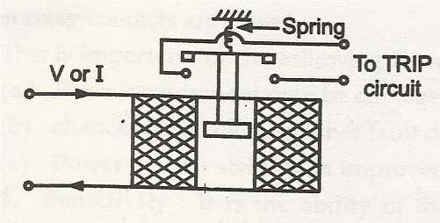
1. Attracted Armature Type Relays
These have a coil or electromagnet energized by a coil .The coil is energized by operating quantity like V or I.
Under normal conditions the coil cannot attract the plunger due to spring force.
Under fault condition the fault current increases so armature or plunger gets attracted to close the contacts .

Slide 47
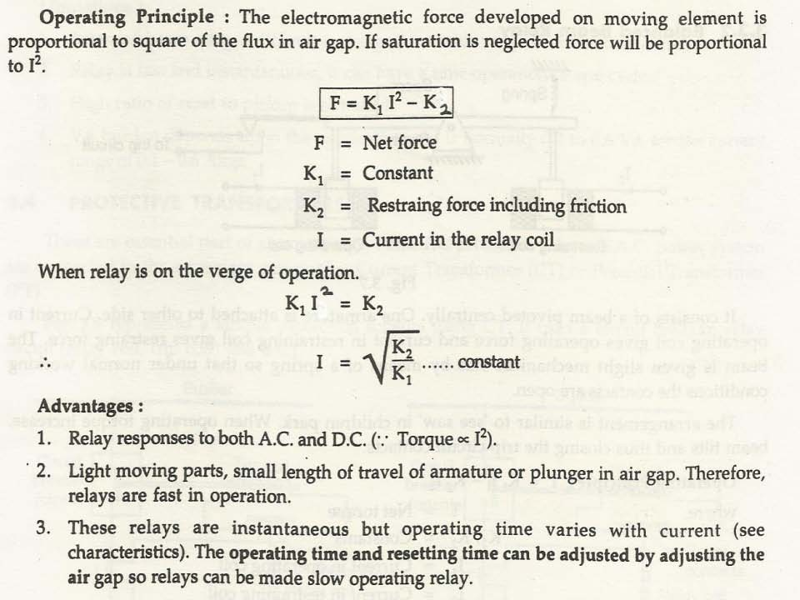
1. Attracted Armature Type Relays
These have a coil or electromagnet energized by a coil .The coil is energized by operating quantity like V or I.
Under normal conditions the coil cannot attract the plunger due to spring force.
Under fault condition the fault current increases so armature or plunger gets attracted to close the contacts .

Slide 48
Attracted armature type
Applications
1.For over current protection
2.Differential Protection
3.Auxiliary Relays
4.Definite time lag over current and earth fault protection

Slide 49
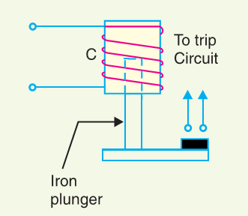
(ii) Solenoid type relay
It consists of a solenoid and movable iron plunger arranged as shown.
Under normal operating conditions, the current through the relay coil C is such that it holds the plunger by gravity or spring in the position shown.
However, on the occurrence of a fault, the current through the relay coil becomes more than the pickup value, causing the plunger to be attracted to the solenoid. The upward movement of the plunger closes the trip circuit, thus opening the circuit breaker and disconnecting the faulty circuit.

Slide 50
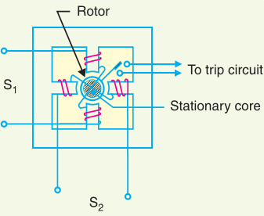
Induction type relay
An induction motor, except that the rotor iron is stationary, rotor conductor portion being free to rotate.
Moving element is a hollow cylindrical rotor which turns on its axis. The rotating field is produced by two pairs of coils wound on four poles as shown.
The rotating field induces currents in the cup to provide the necessary driving torque.

Slide 51
Induction type relay
If φ1 and φ2 represent the fluxes produced by the respective pairs of poles, then torque produced is proportional to Φ1 Φ2 sin α .
Where α is the phase difference between two fluxes.
Induction cup structures are more efficient torque producers than either the shaded-pole or watt hour meter structures.
ADVANTAGES:
type of relay has very high speed
operating time less then 0.1 second

Slide 52
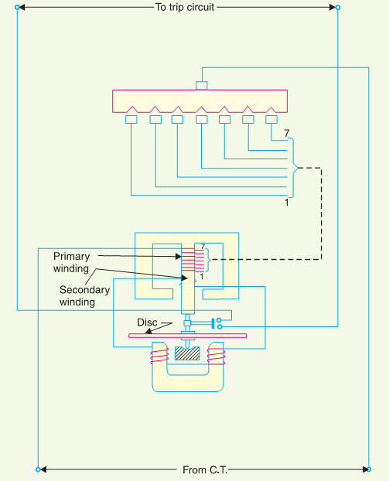
Induction type overcurrent Relay
(Non Directional Relay
when current in the circuit exceeds the predetermined value.
These relays are used on a.c. circuits only and can operate for fault current flow in either direction.
The actuating source is a current in the circuit supplied to the relay from a current transformer.

Slide 53
Constructional Details
It consists of a metallic (aluminum) disc which is free to rotate in between the poles of two electromagnets.
The upper electromagnet has a primary and a secondary winding. The primary is connected to the secondary of a
C.T. in the line to be protected and is tapped at intervals.
The secondary winding is energized by induction from primary and is connected in series with the winding on the lower magnet. The controlling torque is provided by a spiral spring.
The spindle of the disc carries a moving contact which bridges two fixed contacts (connected to trip circuit).
This angle can be adjusted to value between 0° to 360°

Slide 54
Operation(overcurrent relay)
The driving torque on the aluminium disc is set up due to the induction principle. This torque is opposed by the restraining torque provided by the spring.
Under normal operating conditions, restraining torque is greater than the driving torque produced by the relay coil current. Therefore, the aluminium disc remains stationary.
If the current in the protected circuit exceeds the pre-set value, the driving torque becomes greater than the restraining torque. Consequently, the disc rotates and the moving contact bridges the fixed contacts when the disc has rotated through a pre-set angle. The trip circuit operates the circuit breaker which isolates the faulty section.

Slide 55
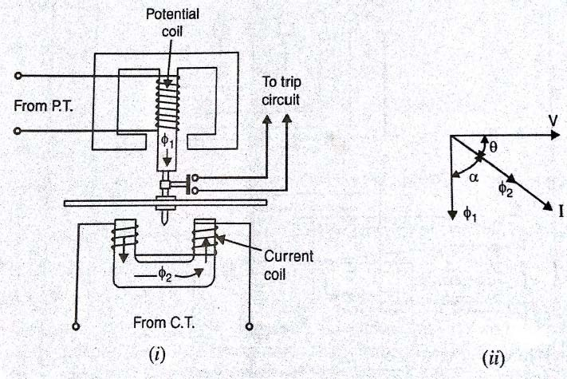
DIRECTIONAL POWER RELAY
Constructional details:
It consist of two electro magnets
upper magnet which is E- shaped
lower magnet which is U- shaped
The upper magnet consist of primary winding on the central limb which is energized by voltage from secondary of P.T
lower magnet houses secondary winding which is energized by current of the circuit from secondary of C.T

Slide 56
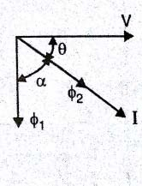
DIRECTIONAL POWER RELAY
This alumunium disc carries a moving contact which can bridge fixed contact by rotating though a pre set angle.
The time of operation depends upon the pre set angle
Restraining torque is provide by spring which twists in reverse direction.
Operation:
from the diagram we can conclude that we have two flux quantities: φ₁& φ₂ . φ₁ lags V by 90 ⁰ φ₂ inphase with current I

Slide 57
DIRECTIONAL OVER CURRENT RELAY:
From the previous discussion
T = V I COS θ
Under abnormal conditions voltage in the circuit is too low.
Therefore the driving torque becomes abnormally too small . Hence the relay does not operate.
i.e., the directional power relay is not suitable for short circuit conditions.
This problem can be overcome by directional over current relay.

Slide 58
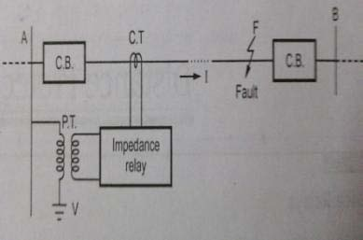
Distance Relay (one of the type is mho relay)
1.IMPEDANCE RELAY
o +ve (operative)Torque by current element
o -ve(restraining)Torque by voltage element
At normal condition
operative torque = restraining torque
At fault
operative torque > restraining torque
Also called voltage restrained over current relay.

Slide 59
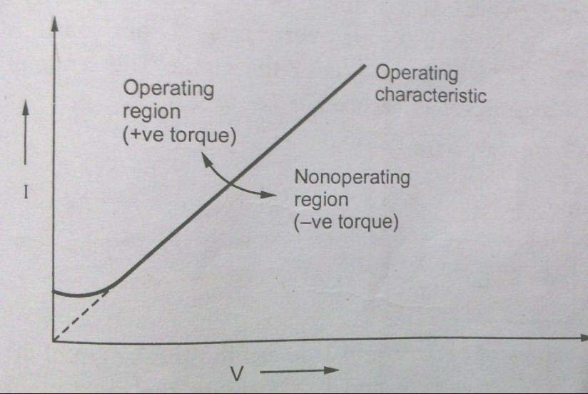
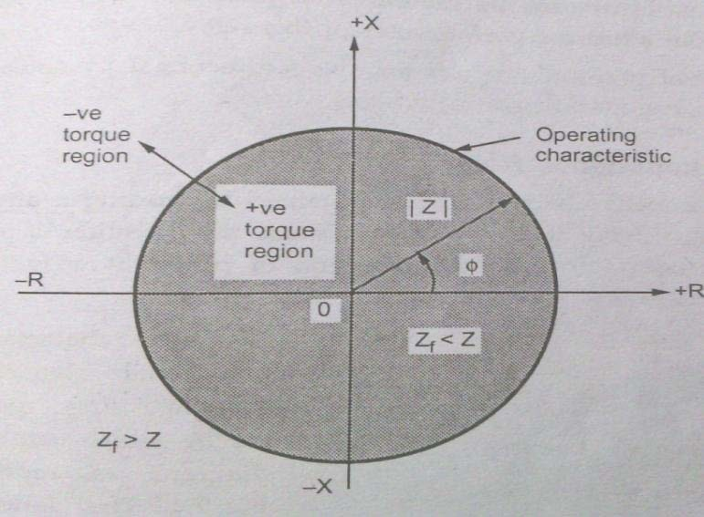
Distance Relay (one of the type is mho relay)

Slide 60
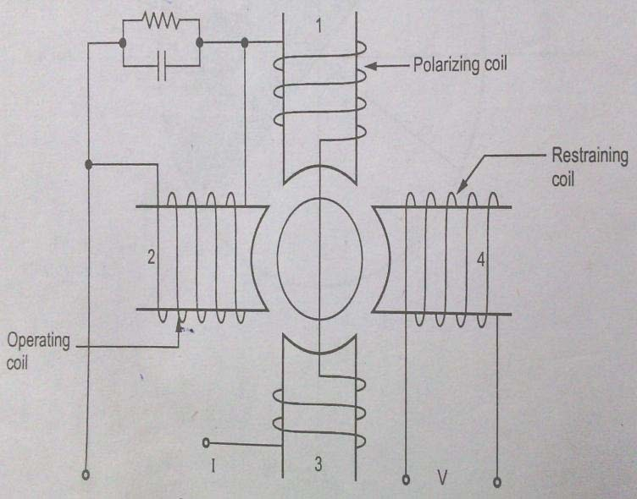
2. REACTANCE RELAY :-
Operative Torque by current
Restraining Torque by Current-Voltage Directional relay
❖ +ve torque by over current element
-ve torque by directional unit
Directional element designed for maximum Torque angle = 90 degree

Slide 61
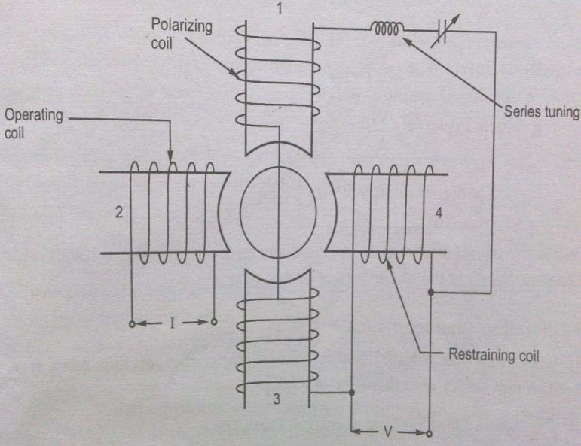
(Admittance relay):-
Induction cup type structure.
oOperative Torque produced by V & I element.
o Restraining Torque by Voltage element.
Also called Admittance relay.

Slide 62
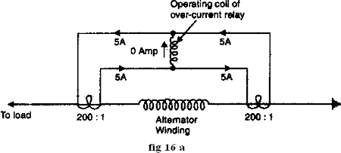
Differential Relays
A two-winding relay that operates when the difference between the currents in the two windings reaches a predetermined value is called differential relays.
A two-winding relay that operates when the difference between the currents in the two windings reaches a predetermined value.
current differential relay
voltage differential relay
Biased beam relay or percentage differential relay
(i) Current balance protection
Figure shows an arrangement of an over current relay connected to operate as a differential relay. A pair of identical current transfonners is fitted on either end of the section to be protected (alternator winding in this case). The secondaries of CT’s are connected in series in such a way that they carry the induced currents in the same direction. The operating coil of over current relay is connected across the CT secondary circuit. This differential relay compares the current at the two ends of the alternator winding.

Slide 63
Differential Relays
Disadvantages
The impedance of the pilot cables generally causes a slight difference between the currents at the two ends of the section to be protected, then the small differential current flowing through the relay may cause it to operate even under no fault conditions.
Pilot cable capacitance causes incorrect operation of the relay when a large current flows
Accurate matching of current transformers cannot be achieved due to pilot circuit impedance

Slide 64
Voltage Differential Relays
In this scheme of protection, two similar current transformers are connected at either end of the element to be protected (e.g. an alternator winding) by means of pilot of wires.
The secondary of current transformers are connected in series with a relay in such a way that under normal conditions, their induced e.m.f’s are in opposition
Disadvantages
The voltage balance system suffers from the following drawbacks
A multi-gap transformer construction is required to achieve the accurate balance between current transformer pairs.
The system is suitable for protection of cables of relatively short, lengths due to the capacitance of pilot wires.

Slide 65
Biased beam relay or percentage differential relay
The biased beam relay also called percentage differential relay is designed to respond to the differential current in terms of its fractional relation to the current flowing through the protected section.
It’s called percentage differential relay because the ratio of differential operating current to average restraining current is a fixed percentage.
It’s called bias relay because restraining known as biased coil produces the bias force. Fig 17 a, shows the schematic arrangements of biased beam relay. It is essentially an over current balanced beam type relay with an additional restraining coil. The restraining coil produces a bias force in the opposite direction to the operating force.

Slide 66
Static relay
The static relay is the next generation relay after electromechanical type.
The Solid Static relays was first introduced in 1960’s. The term ‘static’ implies that the relay has no moving mechanical parts in it.
Compared to the Electromechanical Relay, the Solid Static relay has longer life-span, decreased noise when operates and faster respond speed.
The static relays have been designed to replace almost all the functions which were being achieved earlier by electromechanical relays.

Slide 67
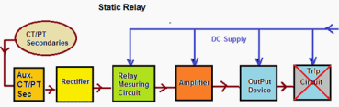
Static relay(Principle of operation)
The essential components of static relays are shown in figure below. The output of CT and PT are not suitable for static components so they are brought down to suitable level by auxiliary CT and PT. Then auxiliary CT output is given to rectifier.
Rectifier rectifies the relaying quantity i.e., the output from a CT or PT or a Transducer.

Slide 68
Static relay(Principle of operation)
The rectified output is supplied to a measuring unit comprising of comparators, level detectors, filters, logic circuits.
The output is actuated when the dynamic input (i.e., the relaying quantity) attains the threshold value. This output of the measuring unit is amplified by amplifier and fed to the output unit device, which is usually an electromagnetic one.
The output unit energizes the trip coil only when relay operates.
Advantages of Static Relays
Low Weight
Arc less switching
Static Relay burden is less than electromagnetic type of relays. Hence error is less.
Fast response.
Long life
Less power consumption
More Accurate compared to electromechanical Relay

Slide 69
Comparator
The magnitude of voltage & current and phase angle between them may change when a fault occurs.
Static relay senses the change in these parameters to differentiate between healthy and faulty conditions.
This is achieved by comparing either the magnitudes of voltage & current or the phase angle between them.
The circuitry which performs this function is called comparator.
Two types – amplitude comparator and phase comparator

Slide 70
Amplitude Comparator
It compares the magnitude of two input quantities irrespective of the angle between them.
The two quantities are operating quantity and restraining quantity.
When the magnitude of the operating quantity is greater than the restraining quantity, the relay sends trip signal to C.B.
i) Circulating current comparator ii)Opposed voltage comparator

Slide 71
Phase Comparator
Period of coincidence of +ve polarity of 2 signals are compared with a reference angle. (usually 90 degree) .
If the 2 signals have a phase difference of ɸ, then the angle of coincidence ψ = 180 - ɸ.
If ɸ < 900 , then ψ > 900 . The phase comparator may be designed to trip the C.B, when ψ > 900 .
The period of coincidence is measured by different techniques

Slide 72
Feeder Protection Relays
One of the important protections in Power System Protection is Feeder Protection.
Different types of relays are used for feeder protection like electromagnetic type relays, static type relays etc. But now a day we are using Numerical relays for all protections.
The benefits of Numerical relays are,
Accurate tripping,
Less tolerance,
Fault events and counter storage
Display of fault parameters on screen

Slide 73
  MODULE-03
APPARATUS PROTECTION

Slide 74
Fault and Abnormal Conditions
The two major items of equipment in a power system are the generators and transformers. They have very high chance of fault occurrence and usually takes much time and money to repair the damage.
Generator : Over Current, Over Voltage, Under Voltage, Under Frequency, Unbalanced Current, Loss of Excitation, Reverse Power, Winding Inter turn Fault, Winding Earth Fault etc.
Transformer : Over Current, Winding Inter turn fault, Excessive Temperature Rise, Unbalance Current, Over fluxing etc.
Motors : Over Current, Under Voltage, Unbalance Current, Winding Short Circuit, Stator Earth Fault, etc.
Transmission Line : Single Phase to ground fault, Phase to Phase Fault, three phase to ground fault, Over Current etc.

Slide 75
Zones of Protection
- Bus Protection
- Generator Protection
- Subtrans Line Protection
- Feeder Protection
- Transformer Protection

Slide 76
TRANSFORMER PROTECTION
There are different kinds of transformers such as two winding or three winding electrical power transformers, auto transformer, regulating transformers, earthing transformers, rectifier transformers etc. Different transformers demand different schemes of transformer protection depending upon their importance, winding connections, earthing methods and mode of operation etc.
It is common practice to provide Buchholz relay protection to all 0.5 MVA and above transformers. While for all small size distribution transformers, only high voltage fuses are used as main protective device. For all larger rated and important distribution transformers, over current protection along with restricted earth fault protection is applied.
Differential protection should be provided in the transformers rated above 5 MVA.
Open-circuit faults, earth faults, phase-to-phase faults, inter-turn faults and overheating are the fault that are likely occur in a transformer
Relays control output circuits of a much higher power.
Safety is increased
Protective relays are essential for keep equipment from being damaged.

Slide 77
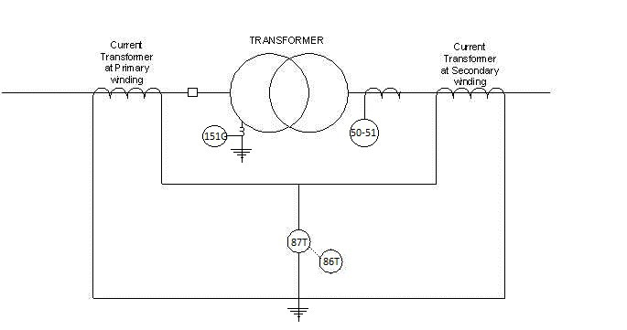
Factors in choosing Protective Gear for a Transformer
Type of Transformer
Size of the Transformer
Type of Cooling
System where used
Importance of service for which it is required
Transformer Relaying Scheme

Slide 78
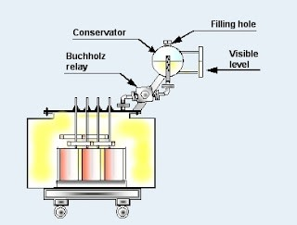
Buchholz Protection
Also known as gas accumulator relay, commonly used on all oil-immersed transformer provided with conservator.
Working Principle:
Whenever a fault occur inside the transformer, the oil of the tank gets overheated and gases are generated. The heat generated by the high local current causes the transformer oil to decompose and produce gas which can be used to detect the winding faults

Slide 79
Generator Protection
Generator is the most precious/valuable equipment in PP which actually converts the mechanical energy of turbine into electricity.
Various relays are used to detect abnormalities and whenever fault conditions appear, they can give warning alarms to trip the unit automatically.
Generally automatic tripping are provided if the time for operator to take corrective action is less or the fault is likely to cause serious damage to the unit.

Slide 80
FAULT IN THE GENERATOR
Stator
  Phase to Phase fault.
  Inter – turn fault
  Earth fault (80% & 100%)
Rotor
  Two stage relay:
  a)Alarm
  b) Trip
  Over voltage in the rotor.
Which affects the generator
Negative Phase sequence
Loss of Excitation
Over fluxing protection
Reverse power
Over-speeding
Pole slipping/ Out of Step

Slide 81
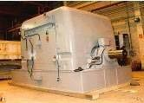

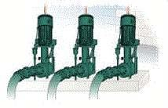
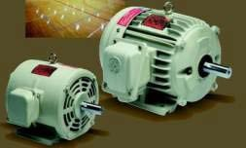
MOTOR PROTECTION
Various Industry Motor Application
Fan, Blower
Pump, Compressor
Conveyor
Mixer
Cranes

Slide 82
Types of Fault in Motors
External Fault
Mechanical Load
Unbalance Supply Voltage
Single Phasing
Phase Reversal
Internal Fault
Bearing Failure
Winding phase and earth fault

Slide 83
Motor Protection Summary
THERMAL OVERLOAD
SHORT CIRCUIT
EARTH FAULT
UNBALANCE
BLOCKED ROTOR/STALLING PROTECTION

Slide 84
Motor Protection Stalling
Required for
Stalling during starting Stalling during running
Cases
Starting time < Stall withstand time
Stall withstand time< Starting time

Slide 85
CURRENT RELAYS
IDMT RELAYS :
These relays have inverse characteristic and the operating time decreases as the magnitude of current increases.
GENERAL RELAY EQUATION :
t = TMS X K/((I/In)^n – 1)
t = RELAY OPERATING TIME I = FAULT CURRENT
n = CONSTANT K = CONSTANT
In = RELAY PLUG SETTING ( PICK UP ) TMS = TIME MULTIPLIER SETTING

Slide 86
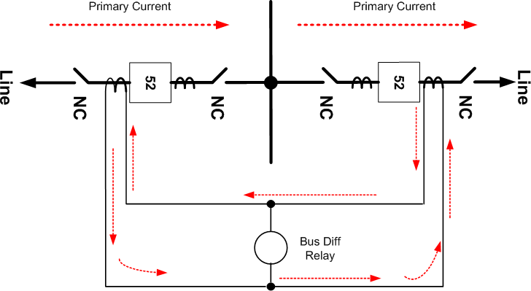
Bus Bar Protection
Bus Differential: Current into bus must equal current out of bus

Slide 87
Bus Bar Protection
Typical Bus Arrangements:
Single bus
Double bus, double breaker
Breaker-and-a-half
Main and transfer buses with single breaker
Ring bus

Slide 88

Bus Bar Protection
Bus differential connection (single-bus)
87B
86B
TRIPS AND LOCKS- OUT ALL BREAKERS CONNECTED TO BUS
NOTE: All CTs connected to the bus differential must have same ratios.

Slide 89



Bus Bar Protection
Bus differential connection (ring bus)
NOTE: No bus differential protection is needed. The busses are covered by line or transformer protection

Slide 90
Bus Bar Protection
Two Busbar Protection Schemes:
Low Impedance - using time overcurrent relays
  inexpensive but affected by CT saturation.
  low voltage application; 34.5kV and below
High Impedance - using overvoltage relays (this scheme loads the CTs with a high impedance to force the differential current through the CTs instead of the relay operating coil.)
  expensive but provides higher protection security.
  115kV and above voltage application or some 34.5kV bus voltages which require high protection security.

Slide 91
Transmission line Protection
Distance Protection
Over Current Protection
Differential Protection.
Main and Back up Protection

Slide 92
Distance Relay Protection
The basic principle is that the apparent impedance seen by the relay reduces drastically in case of line fault.
If the ratio of apparent impedance to the positive sequence impedance is less than unity, it indicates a fault.
This protection scheme is inherently directional.
Impedance relay and Mho relay use this principle.

Slide 93
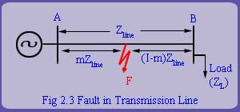
Distance Relay Protection
The basic principle is that the apparent impedance seen by the relay reduces drastically in case of line fault.
If the ratio of apparent impedance to the positive sequence impedance is less than unity, it indicates a fault.
This protection scheme is inherently directional.
Impedance relay and Mho relay use this principle.

Slide 94
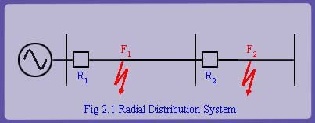
Over Current Relay Protection
Principle of Over current Protection
When the current in a system exceeds a predetermined value, it indicates the presence of a fault.
Relaying decision is based solely on the magnitude of current.
Over current relaying and fuse protection uses this principle
Used in radial distribution systems.

Slide 95
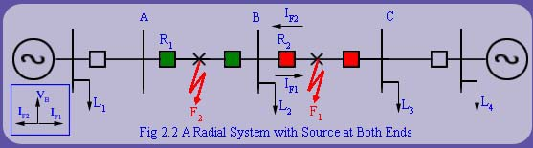
Directional Over Relay Protection
Directional Over current Protection Uses both magnitude of current and phase angle information for decision making.
Used in radial distribution systems with source at both ends

Slide 96
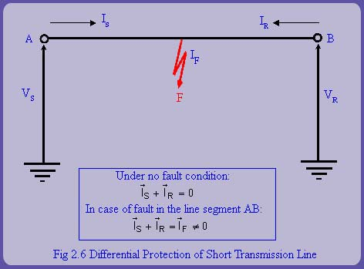
Differential Relay Protection for Transmission Line
By comparing the two currents either in magnitude or in phase or in both, fault can be determined.
Its implementation requires a communication channel.
It is extremely accurate.

Slide 97
Differential Relay Protection for Transmission Line
By comparing the two currents either in magnitude or in phase or in both, fault can be determined.
Its implementation requires a communication channel.
It is extremely accurate.

Slide 98
  MODULE-04
SWITCHGEAR & CIRCUIT BREAKER

Slide 99
What is Switchgear?
Switchgear is the combination of switches, fuses or circuit breakers(CB) used to control , protect & isolate electrical equipment.
It is used de-energize equipment & clear faults.

Slide 100
Different elements of switchgear
Circuit breaker
Air ckt breaker ACB
Vacuumed ckt breaker VCB
Oil filled ckt breaker OCB
SF6 CIRCUIT BREAKER
Load Breaking Switch LBS
By pass and changeover switches
Isolators(switches)
Fuses
MCCB (Moulded Case Ckt Breakers)
MCB
(Miniature Circuit Breaker)
RCCB
Residual current circuit breaker

Slide 101
Function wise categories
Automatic & Manual operation
{ example: Circuit breaker ,MCB , MCCB }
Only automatic operation
Fuse
Only manually activated / operated
Isolator, LBS

Slide 102
Voltage wise switchgear categories
Low voltage Switchgear up to 11KV
Medium voltage switchgear up to 66KV
High Voltage switchgear up to 400KV
Extra High Voltage switchgear up to 765KV
HVDC Switchgear

Slide 103
AUTO RECLOSING
Auto reclosing is a phenomenon in which the breaker tries to reconnect the line between two points with the delay or without delay at the time of the fault.
Why we employ Auto reclosers on lines?
As per one estimate, only 5% fault in power system is permanent, others are semi transient or transient in nature, one more estimate stated that about 80% fault (Schneider claims transient fault up to 60 to 70%) at the line is transient in nature. I want to share one feeder tripping of my previous employer company here
Feeder XYZ- Trip-9 times from 5th Feb 2011 to 5th March 2011, Fault traced 1 time and 8 times no fault. We do not have auto reclosers, so due to these transient faults, our loss is due to
Man-hour engaged to the normalized feeder after long petrol of inspection
Fuel cost
Potential revenue lost during an undesired power outage

Slide 104
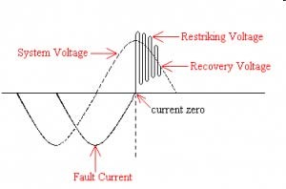
Theory of Circuit Interruption

Slide 105
The ARC
The electric arc constitute a basic ,indispensable and active element in the process of current interruption.
Basic theory of electric discharge
The conduction of electricity is through the gases or vapors which contain positive and negative charge carriers and all types of discharge involve the very fundamental process of production
,movement & absorption of these carriers which is the mode of carrying the current between the electrodes. The gas discharge phenomena can broadly classified as:
  The non-self sustained discharge
  The self sustaining discharges

Slide 106

The ARC

Slide 107

Restriking Voltage & Recovery Voltage
The transient voltage which appears across the breaker contacts at the instant of arc being extinguished is known as restriking voltage.
The power frequency rms voltage ,which appears across the breaker contacts after the arc is finally extinguished and transient oscillation die out is called recovery voltage.

Slide 108
Methods of Arc Interruption
There are two methods of Arc Interruption or Extinction are
  High resistance interruption
  Current zero interruption
  High resistance interruption
The arc resistance can be increased by cooling, lengthening, reducing x- section and splitting the arc.
It is employed for low power AC and DC circuit breakers.
Current zero interruption
There are two theories to explain the zero current interruption of the arc.
Recovery rate theory(Slepain’s Theory)
Energy balance theory(Cassie’s Theory

Slide 109

Recovery rate theory

Slide 110

Arc interruption (or) Extinction methods

Slide 111
INTERRUPTION OF CAPACITIVE CURRENT
Effect:
The interruption of capacitive current produces high voltage transients across the gap of the circuit breaker.
When?
This occurs when an unloaded long transmission line or a capacitor bank is switched off.

Slide 112

TRANSIENT VOLTAGE ACROSS THE GAP OF THE CIRCUIT BREAKER WHEN THE CAPACITIVE CURRENT IS INTERRUPTED

Slide 113
TRANSIENT VOLTAGE ACROSS THE GAP OF THE CIRCUIT BREAKER WHEN THE CAPACITIVE CURRENT IS INTERRUPTED
At instant M
The capacitive current is 0.
System voltage is maximum
If interruption occurs
Capacitor CL remains charged at the maximum value of system voltage.
After the instant M
Voltage across the breaker gap is the difference of Vc and VcL
At the instant N
The voltage across the gap is twice the maximum
Value of Vc.
If the breaker restrikes
The voltage across the gap become partially zero.
Voltage falls from 2Vcmax to zero.
A severe high frequency oscillation occurs (about the point S)
Interrupted again.( if restriking current=0)
The capacitor CL at the voltage -3emax.

Slide 114
TRANSIENT VOLTAGE ACROSS THE GAP OF THE CIRCUIT BREAKER WHEN THE CAPACITIVE CURRENT IS INTERRUPTED
At the instant P
The system voltage reaches its positive maximum.(point T)
Voltage across the gap becomes 4emax.
The capacitive current reaches zero again and there may be an interruption.
The transient voltage oscillates between -3emax and
+5emax. (point P—Q)
Thus voltage across the gap goes on increasing

Slide 115





Slide 116





CIRCUIT BREAKERS
A circuit breaker is an automatically operated electrical switch designed to protect an electrical circuit from damage caused by excess current from an overload or short circuit. Its basic function is to interrupt current flow after a fault is detected.

Slide 117
TYPES OF CIRCUIT BREAKERS
Oil Circuit Breakers
Vacuum Circuit Breakers
Air Blast Circuit Breakers
SF6 Circuit Breakers

Slide 118

OIL CIRCUIT BREAKER
It is designed for 11kv-765kv.
These are of two types
  BOCB (Bulk oil Circuit Breaker)
  MOCB (Minimum oil Circuit Breaker)
The contacts are immersed in oil bath.
Oil provides cooling by hydrogen created by arc.
It acts as a good dielectric medium and quenches the arc

Slide 119
OIL CIRCUIT BREAKER
It is designed for 11kv-765kv.
These are of two types
  BOCB (Bulk oil Circuit Breaker)
  MOCB (Minimum oil Circuit Breaker)
The contacts are immersed in oil bath.
Oil provides cooling by hydrogen created by arc.
It acts as a good dielectric medium and quenches the arc

Slide 120

Bulk Oil Circuit breaker
Air cushion

Slide 121

Low Oil Circuit Breaker
Consists of two parts.
Supporting Chamber.
Circuit-Breaking chamber( consist of fixed and moving contact)

Slide 122
OIL CIRCUIT BREAKER
Advantages
Oil has good dielectric strength.
Low cost.
Oil is easily available.
It has wide range of breaking capability.
Disadvantages:
Slower operation , takes about 20 cycles for arc quenching.
It is highly inflammable , so high risk of fire.
High maintenance cost.

Slide 123

VACCUM CIRCUIT BREAKER
It is designed for medium voltage range (3.3-33kv).
This consists of vacuum of pressure (1*10⁻⁶) inside arc extinction chamber.
The arc burns in metal vapour when the contacts are disconnected.
At high voltage , it’s rate of dielectric strength recovery is very high.
Due to vacuum arc extinction is very fast.
The contacts loose metals gradually due to formation of metal vapours.

Slide 124
VACCUM CIRCUIT BREAKER
Advantages:
Free from arc and fire hazards.
Low cost for maintenance & simpler mechanism.
Low arcing time & high contact life.
Silent and less vibrational operation.
Due to vacuum contacts remain free from corrosion.
No byproducts formed.
Disadvantages:
High initial cost due to creation of vacuum.
Surface of contacts are depleted due to metal vapours.
High cost & size required for high voltage breakers.

Slide 125


AIR BLAST CIRCUIT BREAKERS
This operates using high velocity blast of air which quenches the arc.
It consists of blast valve , blast tube & contacts.
Blast valve contains air at high pressure.
Blast tube carries the air at high pressure & opens the moving contact attached to spring.
There is no carbonization of surface as in VCB.
Air should be kept clean & dry to operate it properly

Slide 126
AIR BLAST CIRCUIT BREAKERS
Advantages
High speed operation as compared to OCB.
Ability to withstand frequent switching.
Facility for high speed reclosure.
Less maintenance as compared to OCB.
Disadvantages:
Little moisture content prolongs arcing time.
Pressure should be checked frequently for frequent operation.
Risk of fire hazards due to over voltages.
It can’t be used for high voltage operation due to prolonged arc quenching.

Slide 127

SF6 CIRCUIT BREAKERS
It contains an arc interruption chamber containing SF₆ gas.
In closed position the contacts remain surrounded by SF₆ gas at a pressure of 2.8 kg/cm² .
During opening high pressure SF6 gas at 14 kg/cm² from its reservoir flows towards the chamber by valve mechanism.
SF₆ rapidly absorbs the free electrons in the arc path to form immobile negative ions to build up high dielectric strength.
It also cools the arc and extinguishes it.
After operation the valve is closed by the action of a set of springs.
Absorbent materials are used to absorb the byproducts and moisture.

Slide 128
SF6 CIRCUIT BREAKERS
Advantages:
Very short arcing period due to superior arc quenching property of SF₆ .
Can interrupt much larger currents as compared to other breakers.
No risk of fire.
Low maintenance, light foundation.
No over voltage problem.
There are no carbon deposits.
Disadvantages:
SF₆ breakers are costly due to high cost of SF₆.
SF₆ gas has to be reconditioned after every operation of the breaker, additional equipment is required for this purpose

Slide 129

Comparison of Circuit Breakers

Slide 130
TESTING OF CIRCUIT BREAKER
Necessary of Testing of circuit breaker:-
Why "Testing of Circuit Breaker" is Necessary?
A Circuit Breaker should be capable of carrying, making, and breaking under normal and abnormal conditions. In any power system circuit breaker has to withstand power frequency over voltages and transient over voltages due to switching and lightning.
The performance of a circuit breaker under normal and abnormal conditions can be verified by performing different type of tests on circuit breakers. The main purpose of testing of circuit breakers is to confirm if circuit breaker is able to work on particular voltage and current ratings or not.

Slide 131
TYPES OF TESTING IN CIRCUIT BREAKER
There are two main test classified
Type test 2)Routine Test
  1) Type Tests:
  The purpose of type tests is to prove design features and the quality of circuit breaker. Type tests are not conducted on each circuit breaker. This is done to prove the capabilities and to confirm the rated characteristics of the circuit breakers.
  2) Routine tests
  Routine test is performed before circuit breaker dispatch to ensure the product. This gives result about defects in materials and construction of circuit breaker. We can check quality of material of circuit breaker by performing Routine Test.

Slide 132
Mechanical endurance tests
Thermal tests
Dielectric tests
Measurement of resistance of the main circuits
Short Circuit tests

Slide 133
Mechanical endurance test
In this test, the C.B.. is open and closed 500 times or other value as agreed to between the purchaser and the supplier. The test are carried out without current through the main circuit of the C.B. Out of the total number of tests, 10% should be closed-open operation, that is with the tripping, mechanism energized by the closing of main contacts. During the tests, occasional lubrication, but no mechanical adjustments are permissible. After the tests, all parts including contacts should be in good condition and there should be no permanent distortion and undue wear of the parts
First of all,the master circuit breaker (MB)and the make switch(MS) are closed.
Then,the short circuit current is initiated by closing the test breaker (TB).
The rated short circuit making current i.e.the peak value of the first major loop of the short circuit current envelope is measured from the oscillorgram

Slide 134
Short Time Withstand Current Capacity
In this test, the rated short-time withstand current is applied to the circuit breaker under test for the specified duration of the time.
The rated short time withstand current is equal to be rated short circuit breaking current and standard value of rated duration of short circuit current is 1 second or 3 seconds.
The current is measured by taking an oscillograph of the short circuit current wave. After the test, there should be no mechanical or insulation damage and any contact welding.

Slide 135
Website References
www.slideshare.net
www.scribd.com
www.slideworld.com
www.nptel.ac.in

